Slide 1
Data Science Case Study WITH R
STATISTICS WITH R
Ch.Nanda Krishna
MD rizwanullah
208W1A1299
Assistant Professor
IT B
Information technology

Slide 2
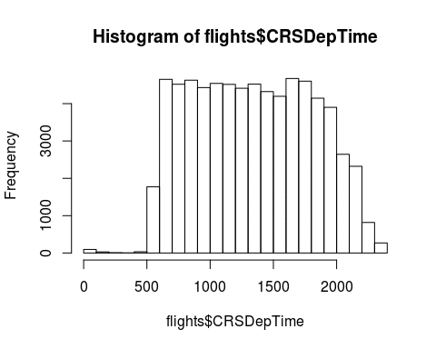
PROBLEM STATEMENT:
Do planes with a delayed departure fly with a faster average speed to make up for the delay?
SOLUTION
we need DepDelay, the delay in minutes at departure, as well as a measure of average speed while flying
A histogram of the departure time shows that the number of flights is relatively constant from 6am to around 8pm and dropping off heavily before and after that.

Slide 3
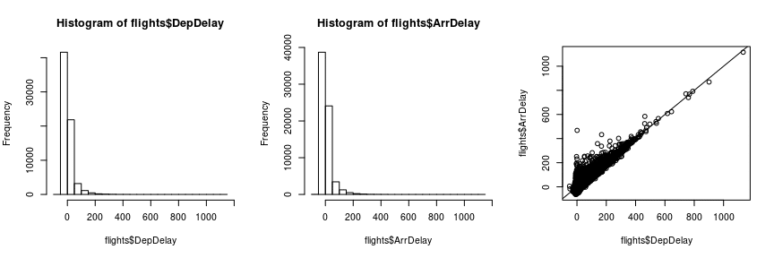
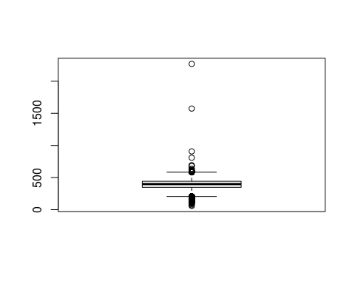
Arrival and departure delay
par(mfrow=c(1,3))
hist(flights$DepDelay)
hist(flights$ArrDelay)
plot(flights$DepDelay, flights$ArrDelay)
abline(0,1)
Create average speed
flights$speed &amp;lt;- flights$Distance / (flights$AirTime/60)
boxplot(flights$speed)

Slide 4
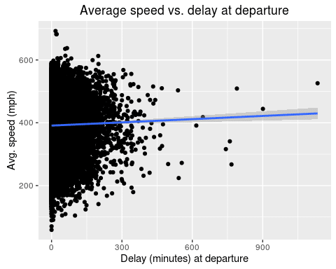
FINAL ANALYSIS :
It seems like there is a slight increase in average speed for planes that leave with a larger delay
This represents the increase in average speed for each minute of delay. So, a plane with 60 minutes of delay will fly 2.04mph faster on average.

